Slide 1
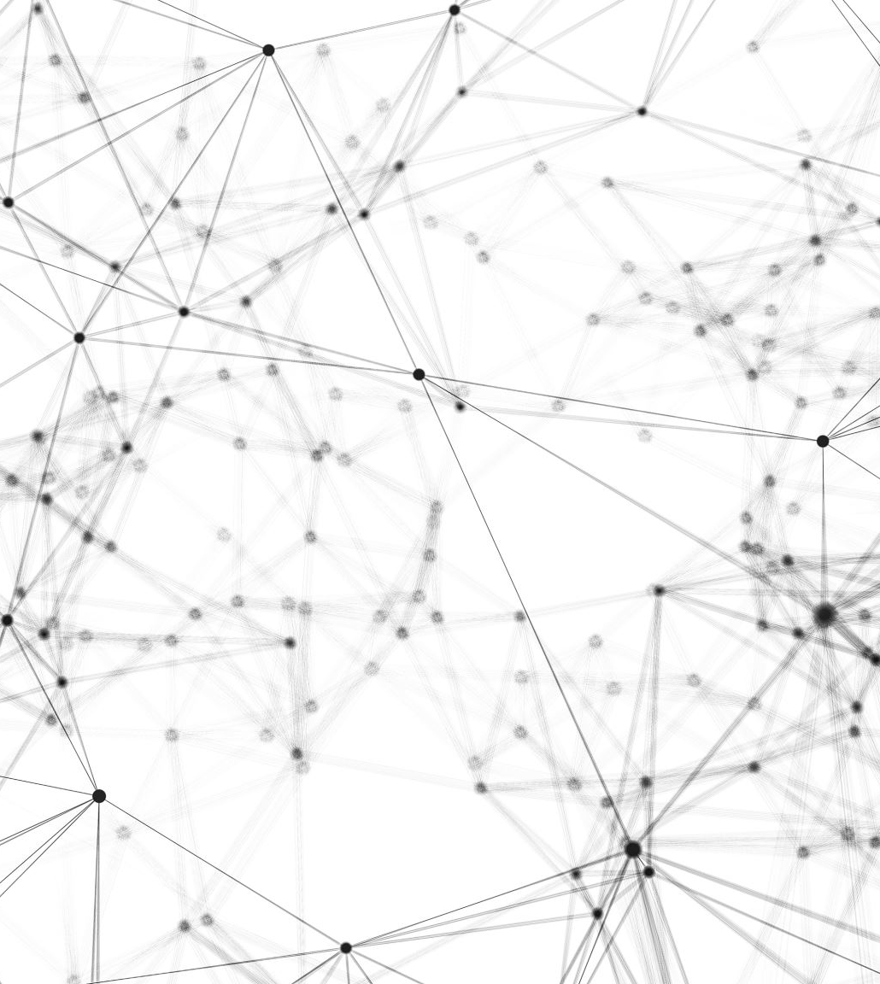
Spotify Top Song Music Genre Classification
James Wang

Slide 2
Dataset Information
Feature | Description
ID | An ID number
title | The song’s title
artist | The artist of the song
Top genre | The genre of the song
year | The year that the song was on the billboards
bpm | The beats per minute, reflects the tempo of the song
nrgy | The energy, represents the energy of the song
dnce | The danceability, represents how easy it is to dance to the song
dB | The loudness, represents how long the song is
live | The liveliness, represents how likely the song is to be a live recording
val | The valence, represents the positive mood of the song
acous | The acoustic, represents how acoustic the song is
spch | The speech, represents spoken words during the song
pop | The popularity, represents the popularity of the song
The Spotify dataset consists of 603 of the most popular songs from 2010 – 2019.
There weren’t any missing values / duplicates
The baseline dataset had the following features:

Slide 3
Spotify Genres
There are over 5000 distinct genres that Spotify can use to label songs
Spotify has created an algorithm that uses “subjective psychoacoustic attributes” and ranks them to other songs to create these different genres
The initial dataset provided contained 50 distinct genres
I attempt to categorize these different music genres within a broader category

Slide 4
Reclassifying Genres
Pop | EDM | Hip Hop R&B | Other
Dance Pop | Electropop | British Soul | Neo Mellow
Canadian Pop | Complextro | Canadian Contemporary R&B | Irish Singer-songwriter
Barbadian Pop | Tropical House | Alternative R&B | Celtic Rock
Art Pop | Brostep | Hip pop | Contemporary Country
Australian Dance | Electro | ATL Hip Hop | Permanent Wave
Acoustic Pop | Downtempo | Hip Hop | Alaska Indie
Folk-pop | Electronic Trap | Escape Room | French Indie Pop
Baroque Pop | Belgian EDM | Detroit Hip Hop | Canadian Latin
Indie Pop | Electro House | Canadian Hip Hop | Latin
Candy Pop | House | Chicago Rap
Danish Pop | Big Room | Australian Hip Hop
Metropopolis
Hollywood
Moroccan Pop
Australian Pop
Colombian Pop
Boy Band

Slide 5
Feature and Simple Model Selection
Feature | Description
Top genre | The genre of the song
bpm | The beats per minute, reflects the tempo of the song
nrgy | The energy, represents the energy of the song
dnce | The danceability, represents how easy it is to dance to the song
dB | The loudness, represents how long the song is
live | The liveliness, represents how likely the song is to be a live recording
val | The valence, represents the positive mood of the song
acous | The acoustic, represents how acoustic the song is
spch | The speech, represents spoken words during the song
pop | The popularity, represents the popularity of the song
The identification features such as title, artist, year, and ID have been removed
I used Principal Component Analysis to reduce the dimensions of these features to 2 principal components in order to allow for ease of visualization
I used Support Vector Machine as the simple classification to try and see the decision boundaries between the different genres being classified
A One vs Rest approach was used to turn the multiclass classification problem into a series of binary classification

Slide 6
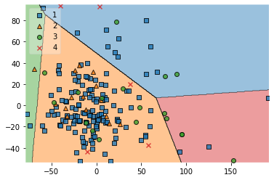
SVM Decision Boundary
4 different decision boundaries created for the 4 different genres
Most songs seem to be incorrectly classified and is located in the wrong decision boundary

Slide 7
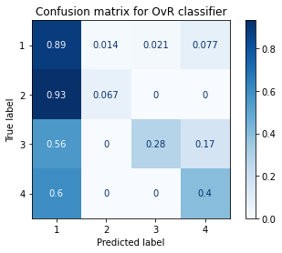
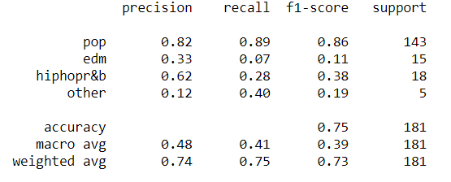
SVM Confusion Matrix and Classification Report

Slide 8
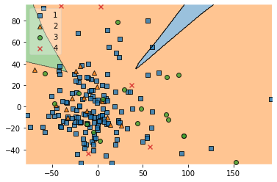
Neural Network Decision Boundary
The Neural Network’s decision boundary is missing a boundary
Nearly all songs fit within one decision boundary which indicates that many songs are being misclassified

Slide 9
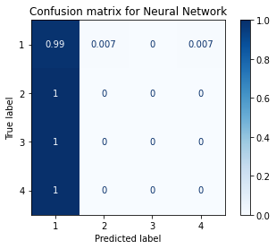
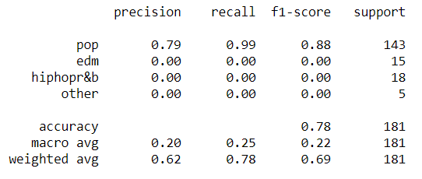
Neural Network Confusion Matrix and Classification Report

Slide 10
Potential Improvements
Work with a larger set of song data.
The models were only able to work with a small subset of all existing songs, so more data will allow for better training of the model and increase the accuracy.
Better accuracy of Music Genre
An accurate list of traditional music genres would be useful compared to self labeling Spotify’s music to follow traditional genres.

Slide 11
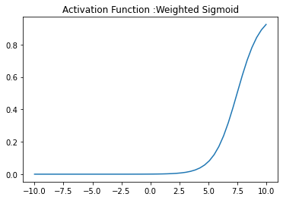
Activation Function: Weighted Sigmoid
Bounded
Nonlinear
Non-convex

